Slide 1
SpiderBro
Dallen, Greg, Nigel, Doug

Slide 2
Outline:
Demonstration
Game Design
Software Design
Questions

Slide 3
Demo time… with some Game Design highlights
Notes:
Plan:
someone plays the game
while someone is playing, another person will explain the actual game design
this is spiderbro
we are a spider
the aim of the game is to stay alive and keep your master free from bugs
we can shoot
we can bite
Enemies can only hurt us if they are suicide bombers
Enemies try to get in the master’s mouth
We have to major types of spawners
static nest
moving queen thats spawns enemies
we have a simple round system
...

Slide 4
Software design

Slide 5
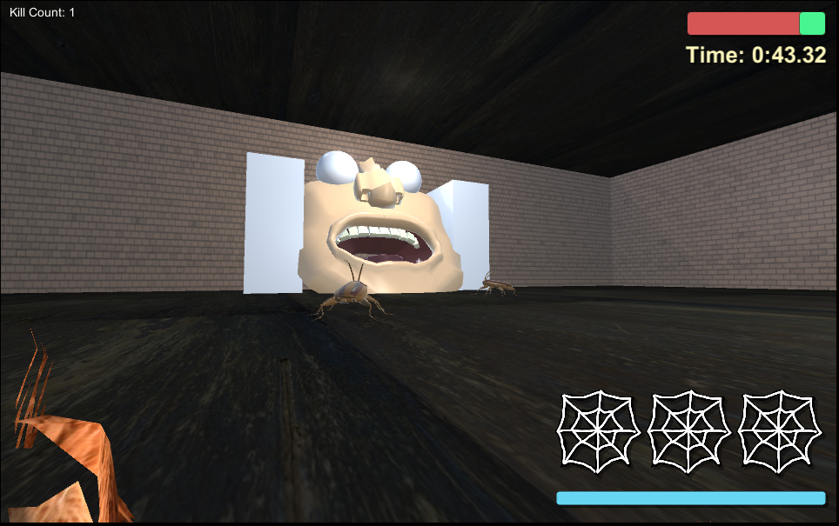
Milestone 2

Slide 6
Milestone 2
Major design and implementation decisions:
FPS spider
one enemy
basic AI that randomly spawns
Decision making: shoots and bites
Goal: Stop the roaches from entering the mouth
Opposition: rapidly spawning roaches made the player struggle
No managing resources
No Game Tokens (maybe in later iterations)
Information: UI elements give player on info and stats
Problems we encountered:
Getting the right difficulty for the spawning rate.
involved lots of trial and error. We eventually found the right balance
Playability: had to hold back on implementing room environment until we were satisfied with the general game mechanics and gameflow.
Learning to use Git as a Group

Slide 7
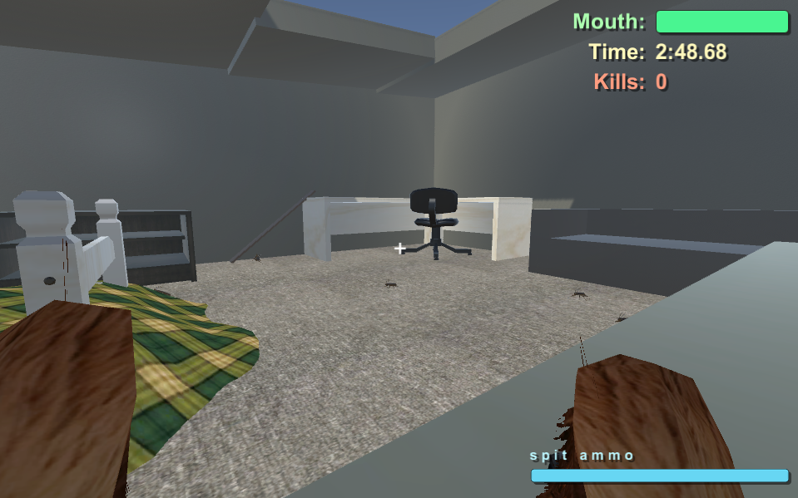
Milestone 3

Slide 8
Milestone 3
Major design and implementation decisions:
Implementation of the initial room idea. Models were added and redesigned.
Adding more sound effects for player-enemy interactions
First iteration that actually looked like a real game.
Problems we encountered:
Clipping issue on the player (kept on glitching). Solution: a simple setting in Unity on the camera.
A lot more roaches tend to flip and travel upside down. Solution: it’s funny, leave it
Lack of choice on how to play. Solution: In Milestone 4 we will add nests…
Attempted to make a 3rd person view. Solution: Found out that with current technical debt, design floors, and complication on getting it to work, the story was dropped.

Slide 9
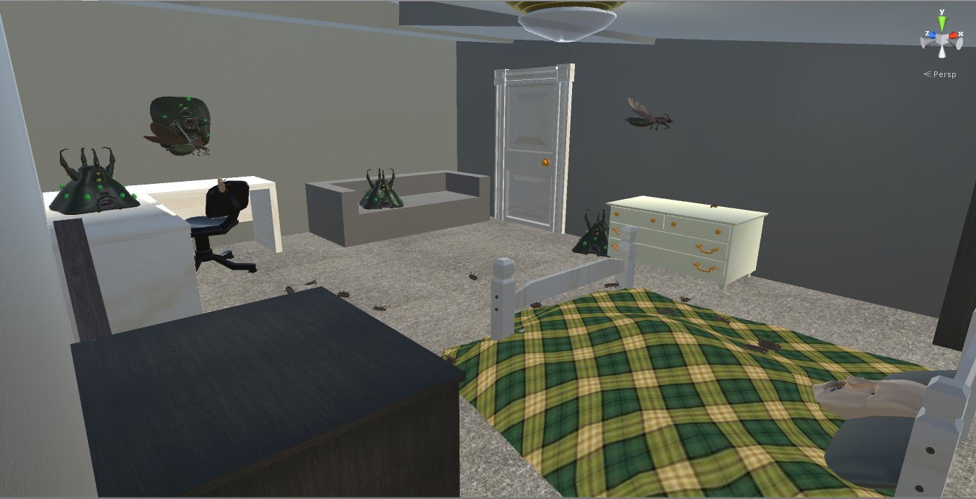
Milestone 4

Slide 10
Milestone 4
Major design and implementation decisions:
Add a round system
Add a static nest that spawn enemies
Add a flying “Queen” that also spawns enemies.
Add a HP system to enemies and player
Add the choice component by letting the player decide how he/she wants to play
Player now has to manage spit ammo as a resource, as regen times are too slow at higher difficulties
Problems we encountered:
Suicide Bugs worked and then didn’t.
wanted to use unity’s complex waypoint system. solution: used simple programming and transforms array to accomplish the same thing (but not as elegant)
Couldn’t get flyingBugs working in time :(

Slide 11
Questions?

